Slide 1
Pictures without Words!

Slide 7
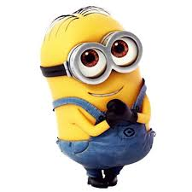

Slide 8
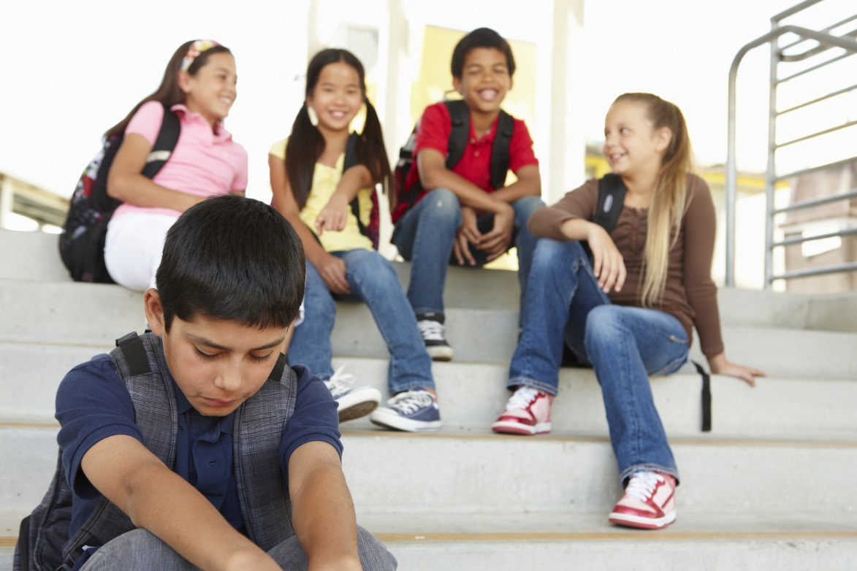

Slide 10
